Slide 1

Contemporary Financial Technology
A FinTech Solution Presentation
By
Group 3

Slide 2
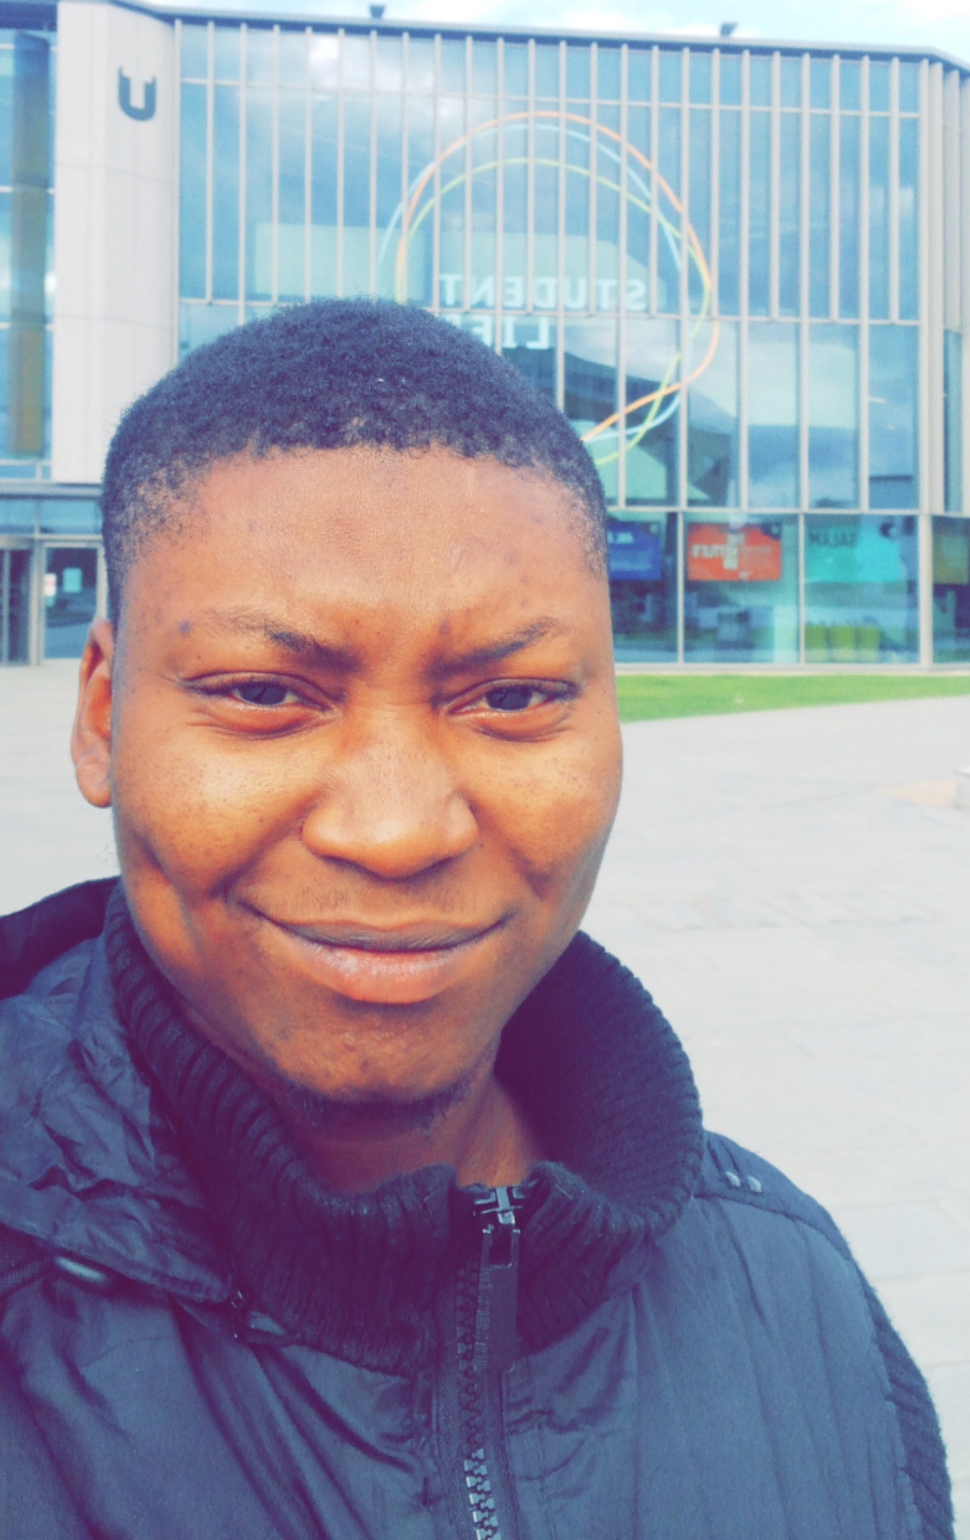
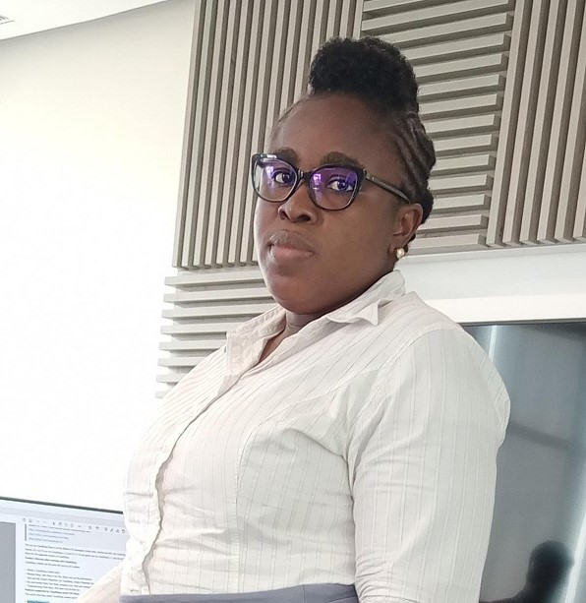

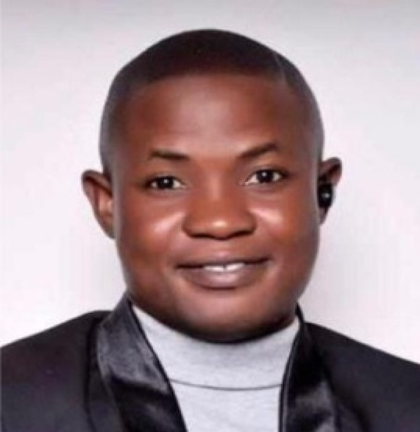
Meet the PLEND Team
Salisu Abdullahi
Afolake Olayemi
Christina Georgiou
Odesola Oluwasegun

Slide 3




Financial Exclusion
Geography : Nigeria
MANY RETAILERS AND INDIVIDUALS ARE UNABLE TO ACCESS LOANS FROM FINANCIAL INSTITUTIONS
This is mainly due to many reasons such as lack of collateral, inconsistent income/turnover, being a foreigner, turnaround time to process loan applications, need to resolve urgent needs.
ON THE OTHER HAND, LENDERS ARE ALWAYS FACED WITH POTENTIAL LOSSES.
This can be due to delay in recoup of funds, lack of knowledge of borrower’s ability to repay.
FUNDS AVAILABILITY FOR INDIVIDUALS & RETAIL MARKET
who do not have the required capital to fund a business idea or pursue a goal as well as retail marketers or individuals looking to invest in new businesses or support another individual or market.

Slide 4
Financial Exclusion
A research conducted in 2019 by Adekoya Adesanya Augustine on CROWDFUNDING AND SMEs FINANCING IN NIGERIA- THREAT AND OPPORTUNITIES highlighted the following abstract
“Crowdfunding is a new dimension of sources of finance which provides Small and Medium Enterprises (SMEs) and other creative ideas initiators the opportunity to raised fund from the crowd by harnessing the power of the internet”
“As a new form of financing opportunity, the key knowledge of the concept is lacking on the part of entrepreneur, the financial expert, academicians and the general public”
“One of the innovative ways for SMEs and creative ideas initiators becoming increasingly important and irreplaceable in promoting economic development is to improve on method of financing through crowdfunding as this had contributed to growth of SMEs in some developed countries.”

Slide 5
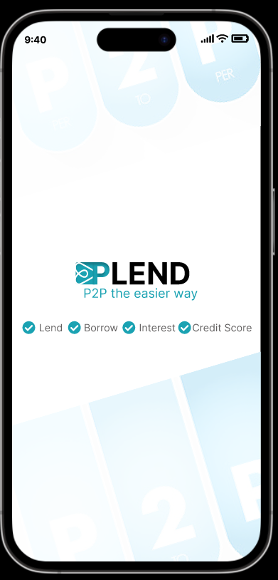
PLEND
Reliable | Instant | Profitable

Slide 6

What is PLEND
community of lenders as well as borrowers connecting with each other to attain financial growth.
Provides support to the borrowers and income to the lenders.
provides the credit score of the borrower providing guarantee to the lender and ensuring borrower does not default.

Slide 7
PLEND Framework
Customer Onboarding
Peer to Peer Lending
Risk Assessment
Lenders Credit Authorization
Reporting and Monitoring
Transaction digitalization and storage
Borrower credit requests
Lender/Borrower Transaction Monitoring
Repayment Documentation
Reputation Scoring
Digital/NFT Collaterals
Credit Reputation Review

Slide 8

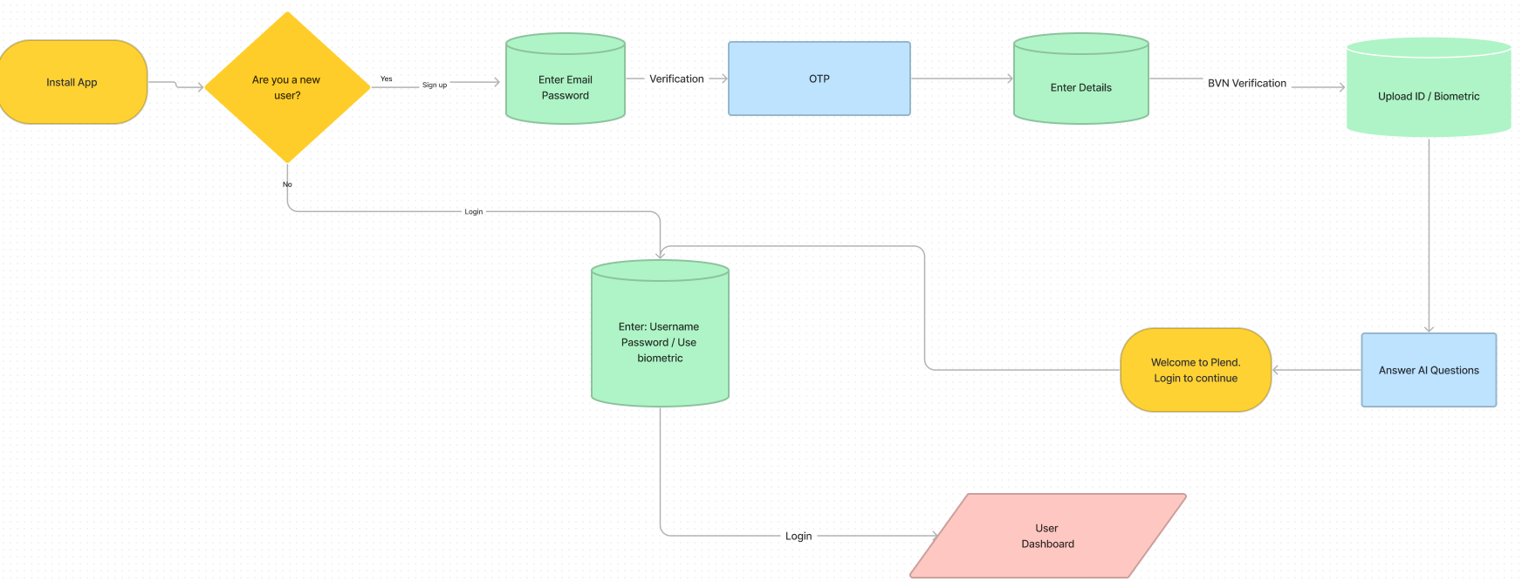
Onboarding
User Journey

Slide 9
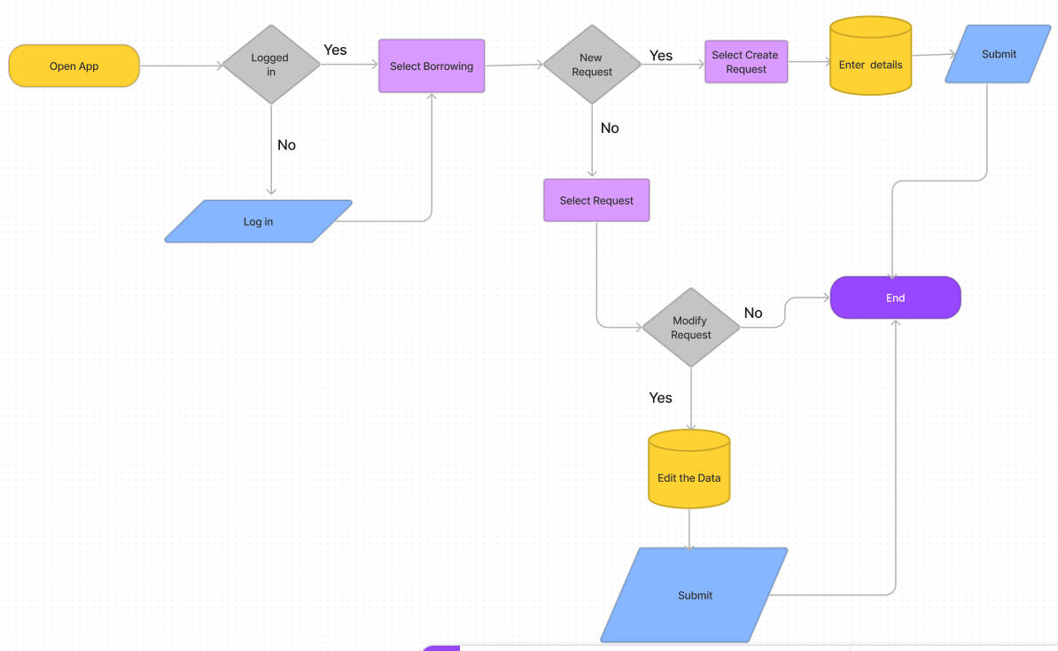
Borrowers
User Journey

Slide 10
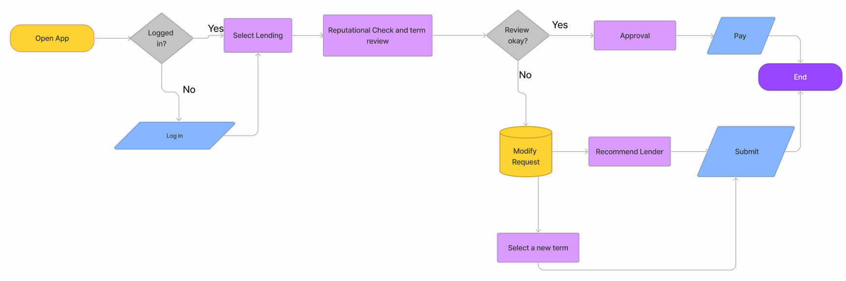
Lenders
User Journey

Slide 11
User Experience/Journey
PLEND Prototype
Turnaround Time
Installing and registration – less than 5 mins #AI INTERACTION
Background check and rating – 30 mins to an hour #API ACTS
Requesting and review – 5 mins

Slide 12
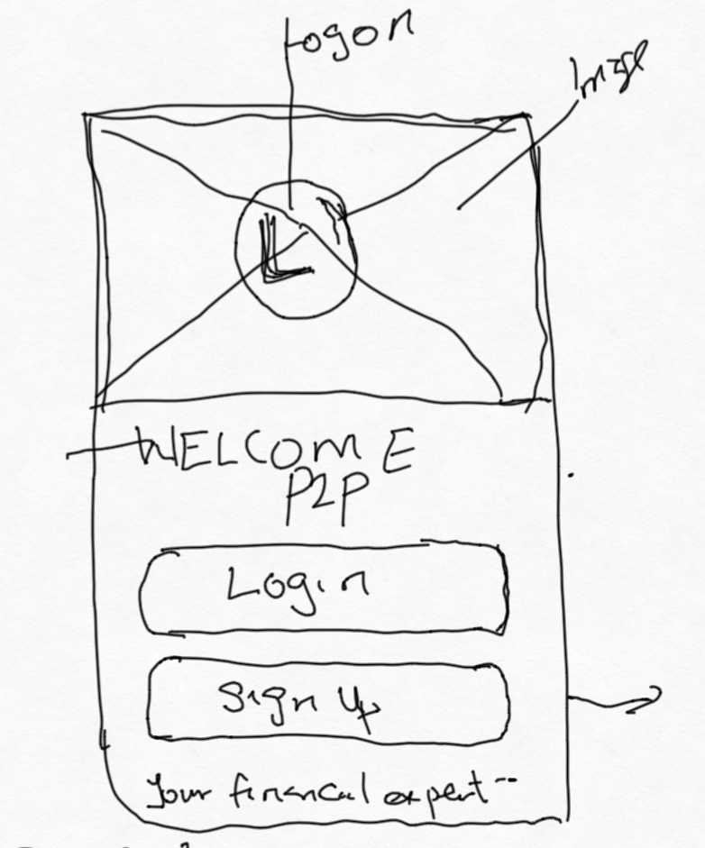
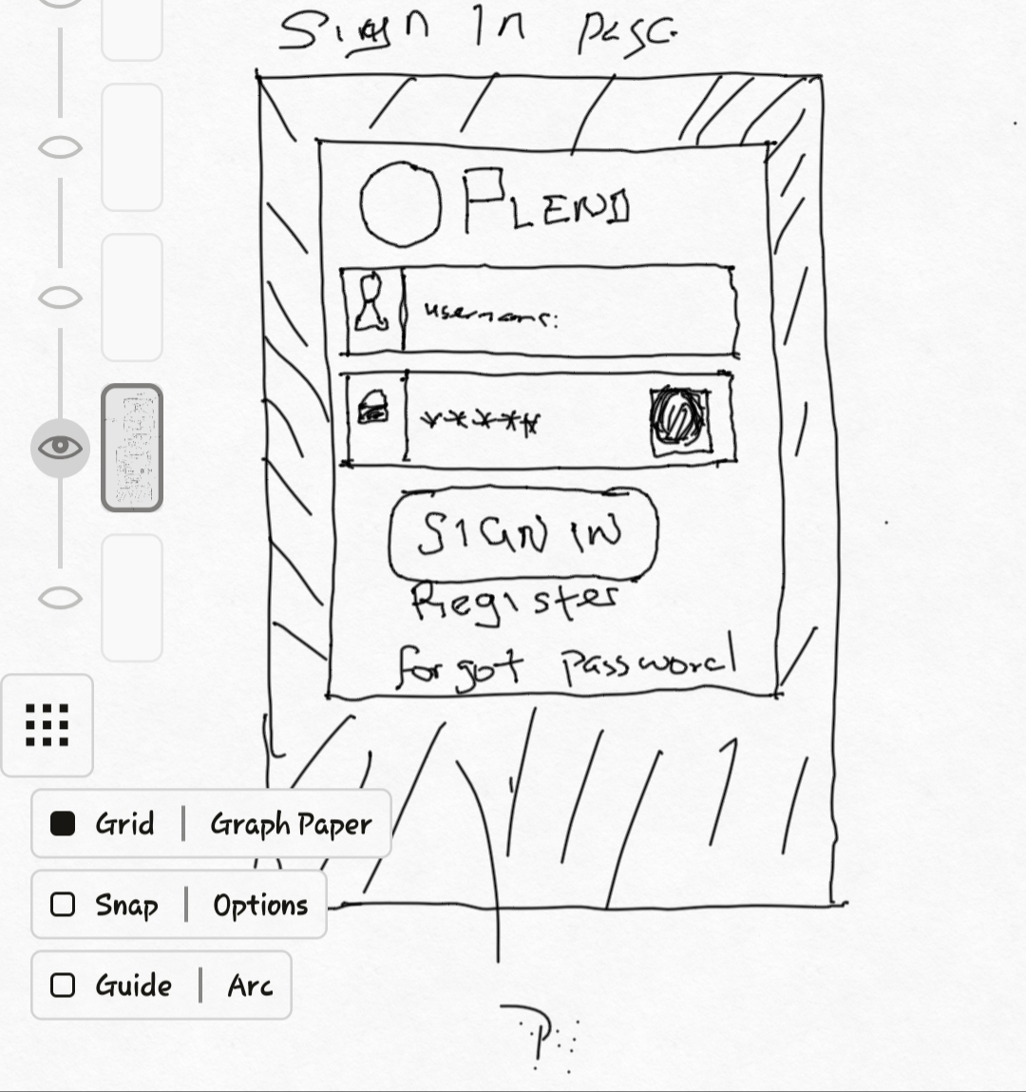
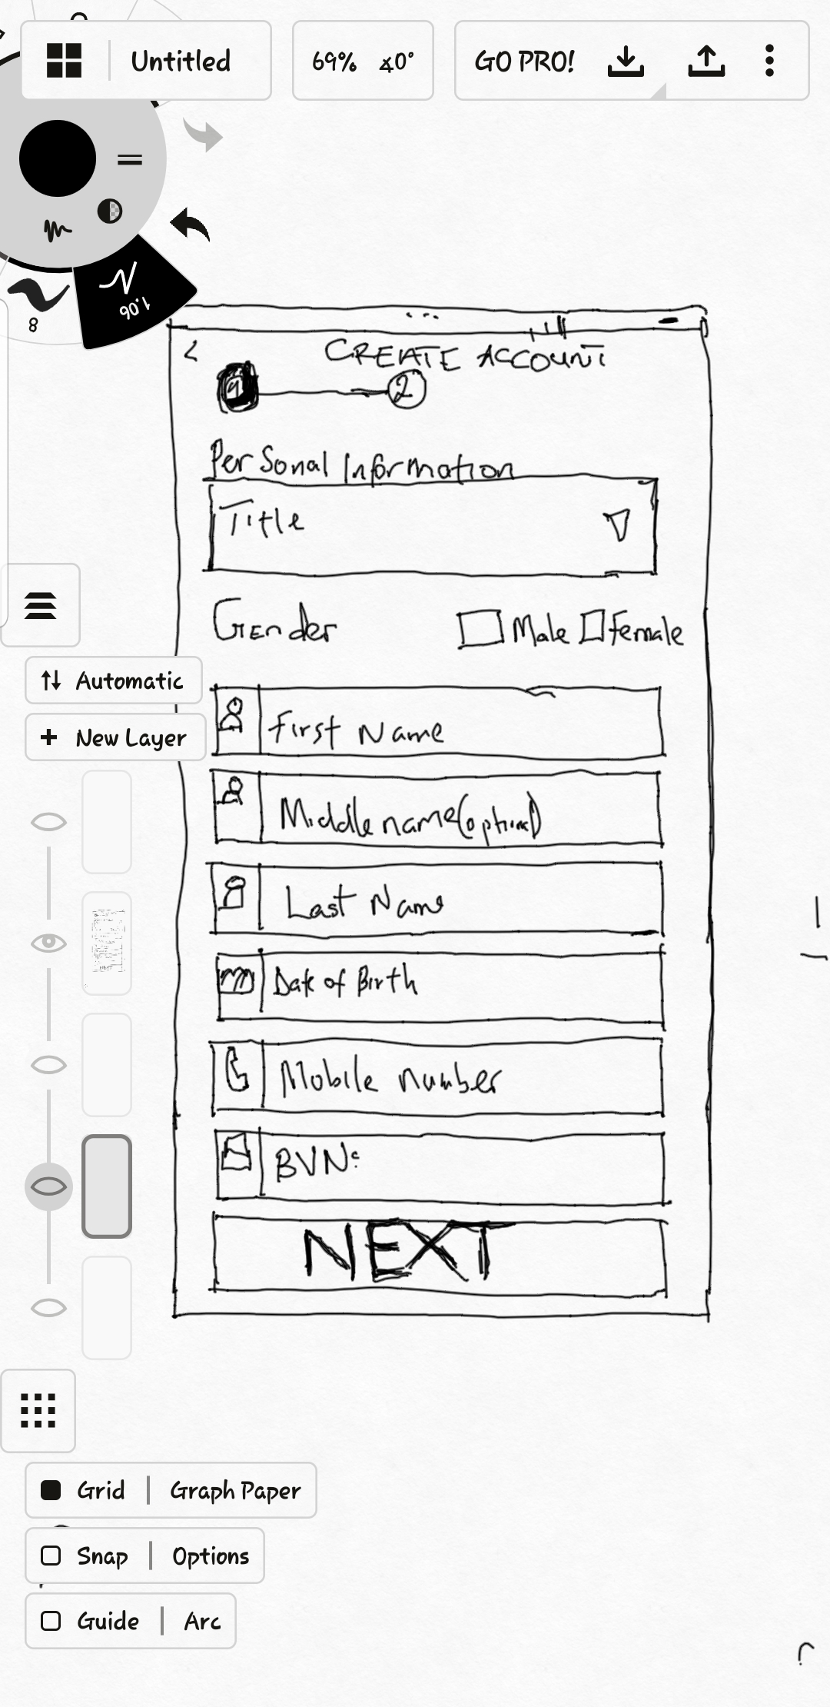
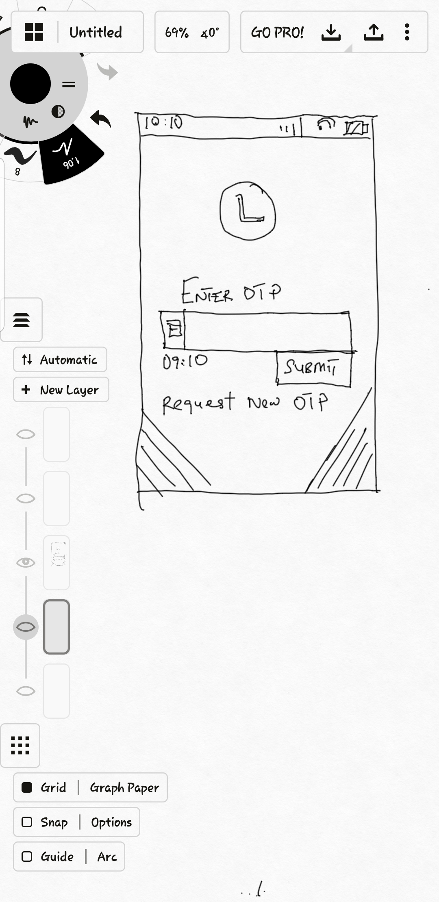
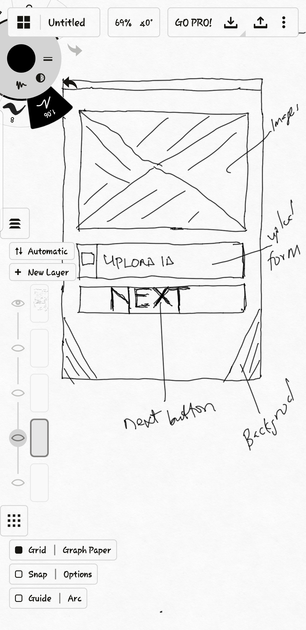
PLEND Wireframe
2022
PLEND Business Plan
12

Slide 13
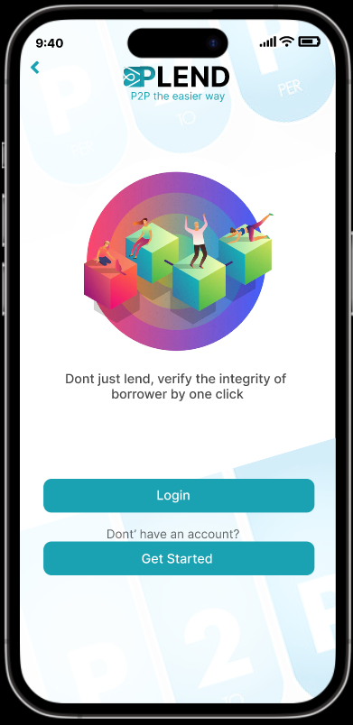
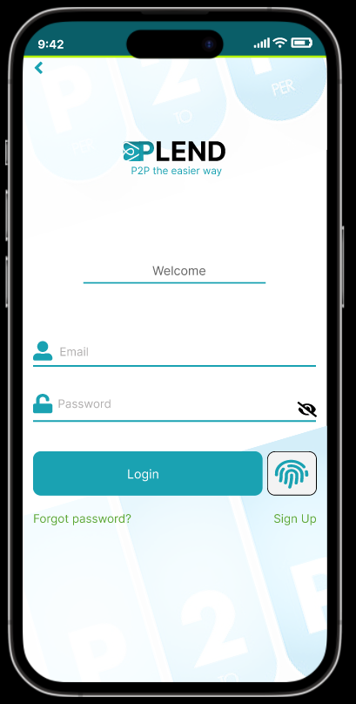
PLEND Onboarding
Existing Customer Login

Slide 14
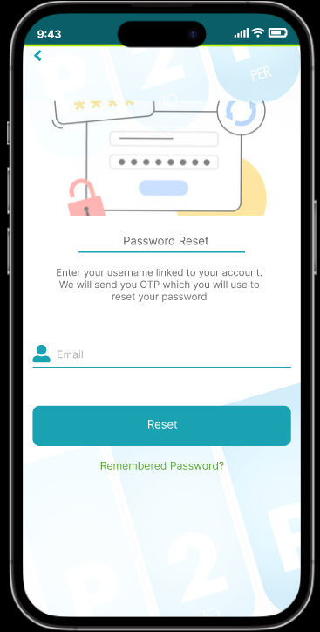
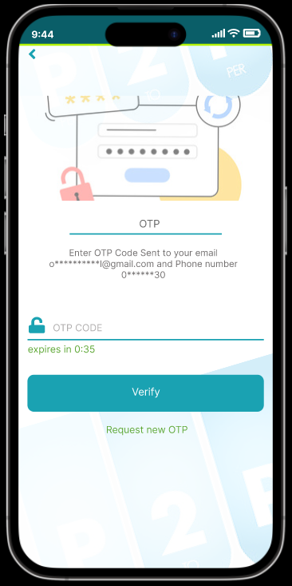
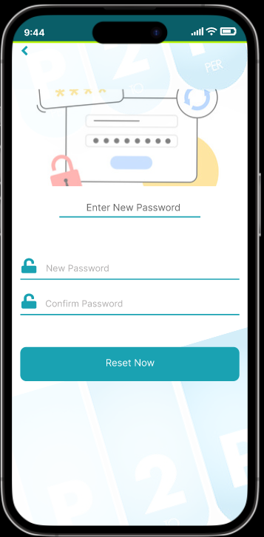
PLEND Onboarding
Existing Customer Password Reset

Slide 15
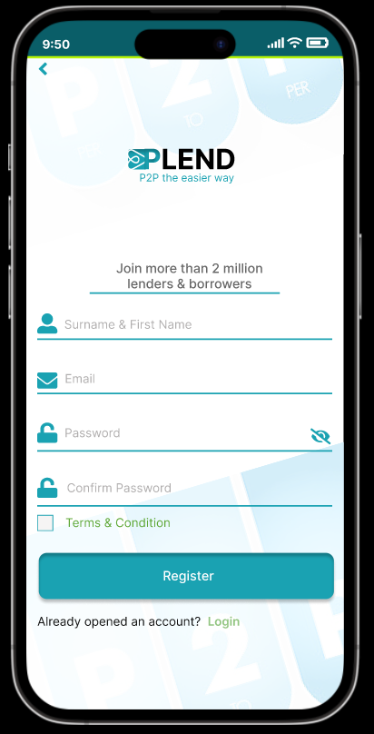
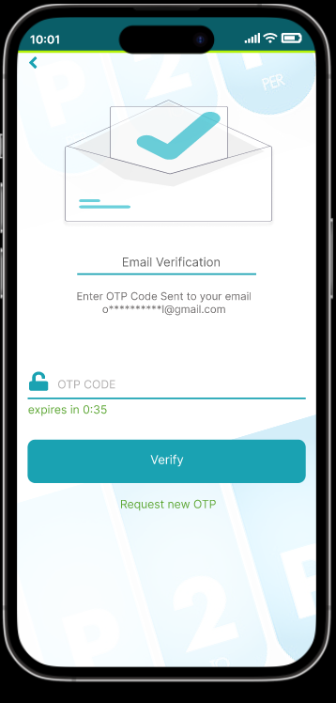
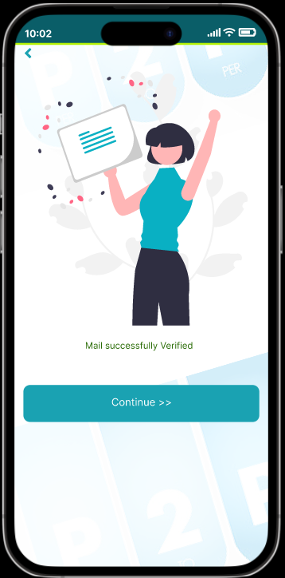
PLEND Onboarding
New Customer Onboarding

Slide 16
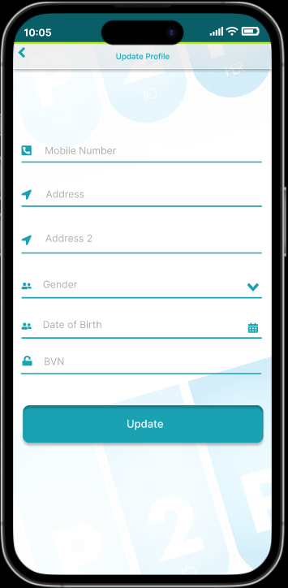
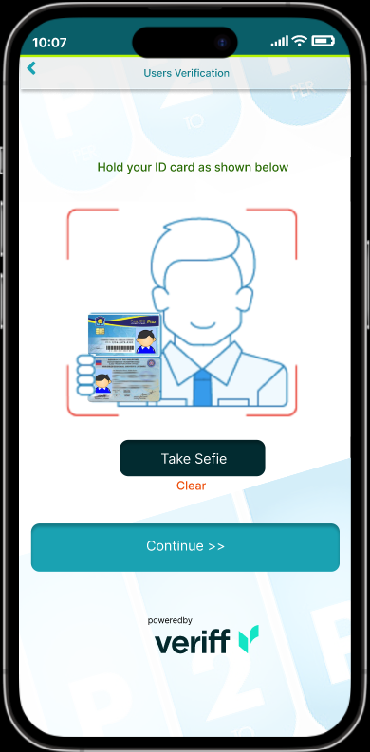
PLEND Onboarding
New Customer Onboarding

Slide 17
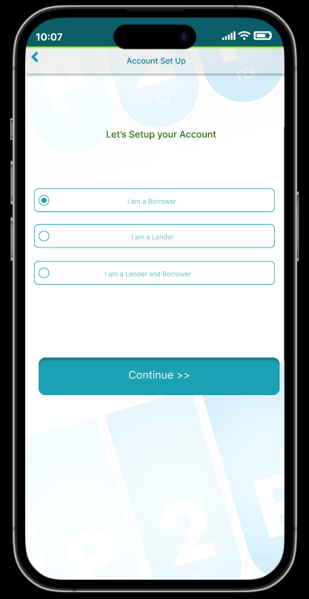
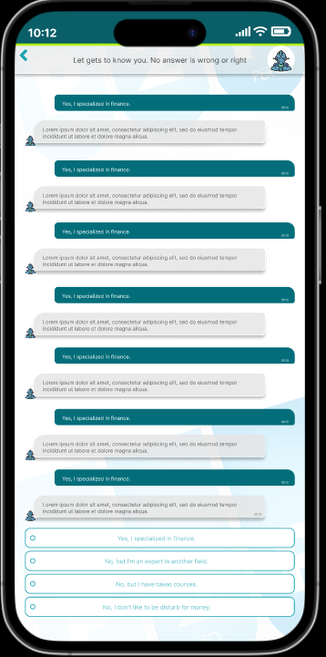
PLEND Onboarding
New Customer Onboarding

Slide 18
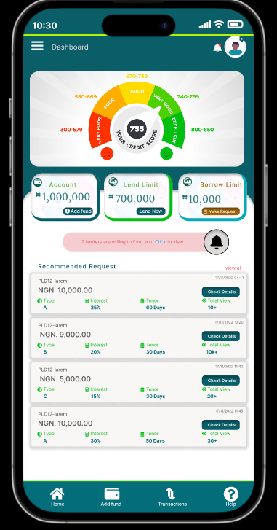
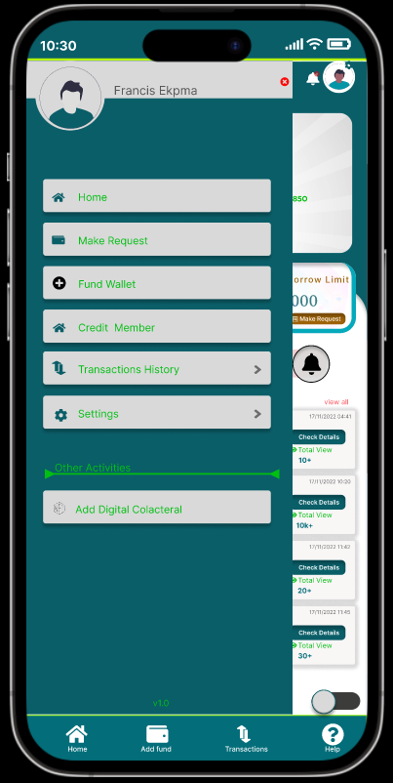
PLEND Peer to Peer Lending
Dashboard

Slide 19
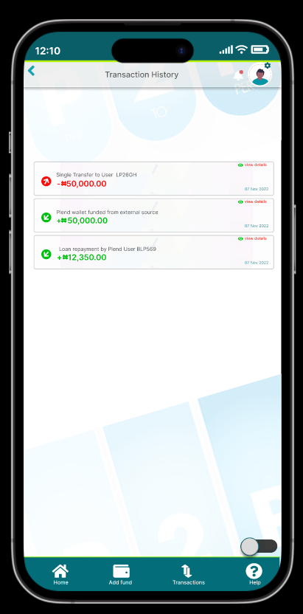
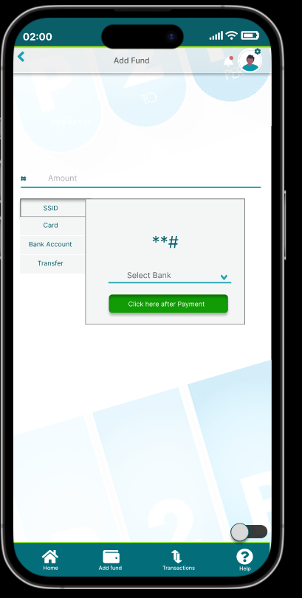
PLEND Peer to Peer Lending
Wallet Funding

Slide 20
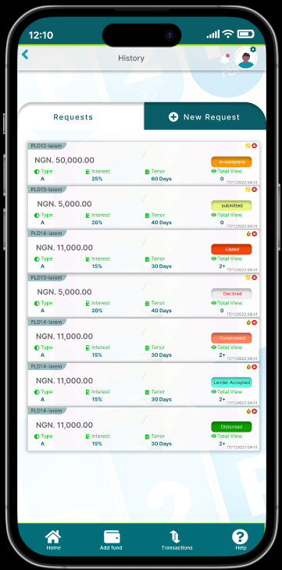
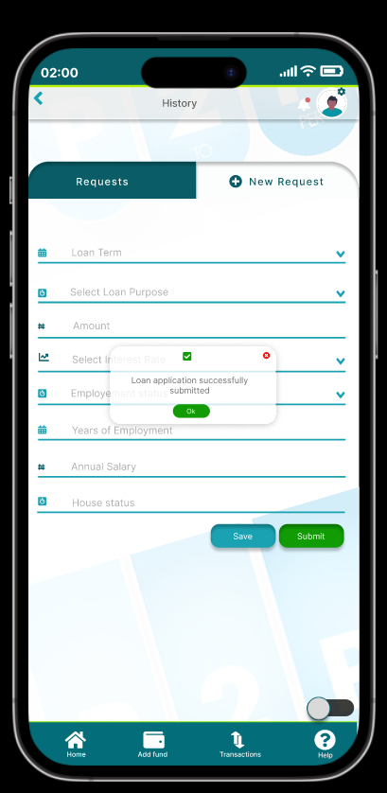
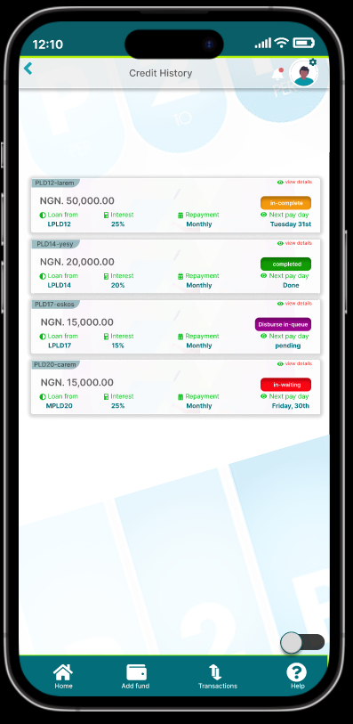
PLEND Peer to Peer Lending
Borrower’s View

Slide 21
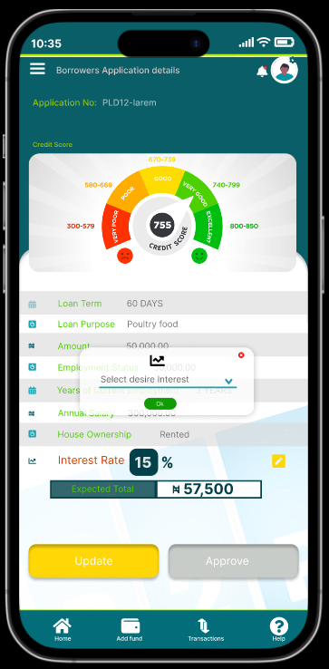
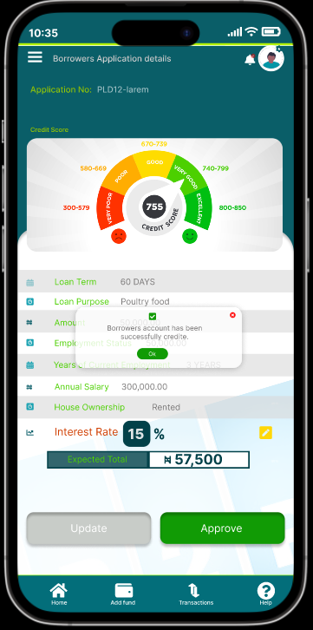
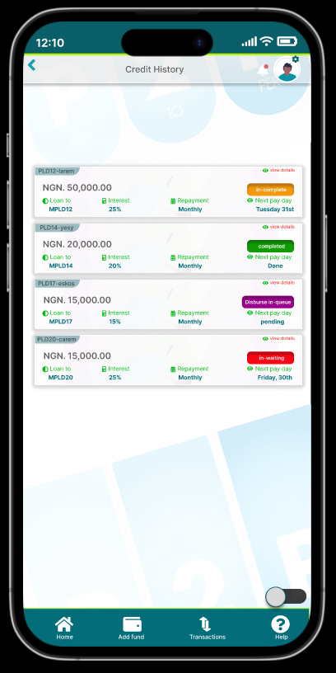
PLEND Peer to Peer Lending
Lender’s View

Slide 22

Key issues
Limit on credit
One-time defaulters
Product will have more features which may require additional learning for customers (digi-collaterals)

Slide 23

Rewards
Chance to improve limit based on subscription
Insurance on Credit given upon subscription
Reputational Score gives insight into credit rating

Slide 24

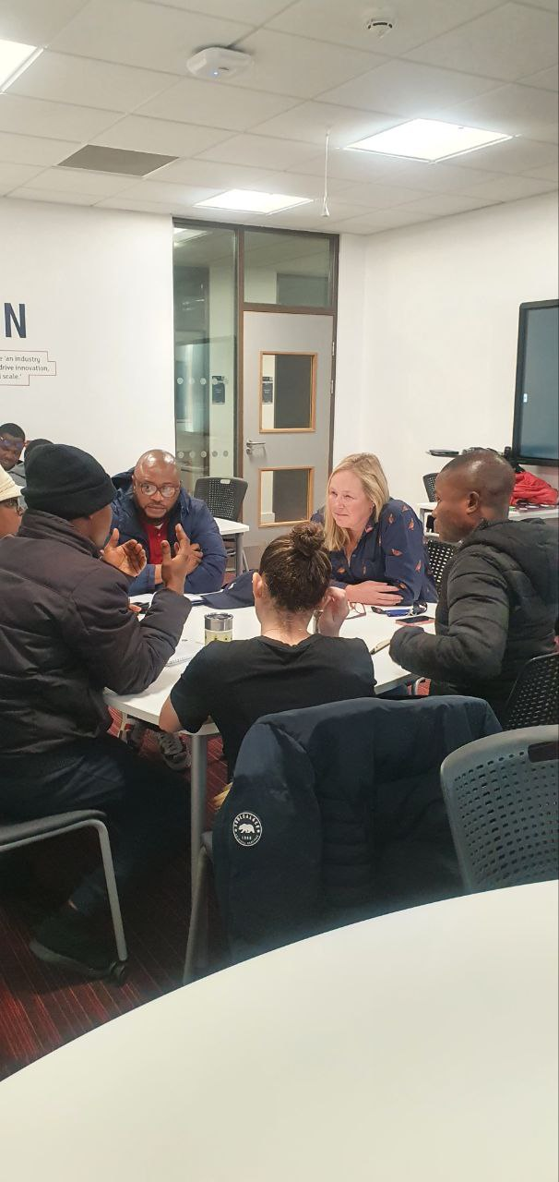
Business Ethics

Slide 25

Data Privacy & Protection
Client Data is protected in accordance with the Nigerian Data protection Regulation (NDPR) (NITDA, Nov 2020)
Consumer is also protected in compliance with the Central Bank of Nigeria (CBN) consumer data protection Regulation
PLEND operates with the regulatory framework of the Central Bank of Nigeria (October 2021)

Slide 26
Data Storage and Usage
Client Data is stored in a hybrid cloud
Private cloud storage which houses all customer data providing a secure environment for customer data in compliance with PCI DSS standards
We may share generic data with the CBN for credit monitoring and update.
We do not sell, trade, or rent Users personal data to others but we may share generic aggregated demographic information not linked to any personal information regarding visitors and users with our business partners, trusted affiliates and advertisers only for the purposes outlined above.
All data privacy, protection, storage and usage policies are fully outlined in the terms and conditions and requires customer consent and agreement to these.

Slide 27
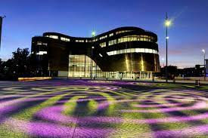
Thank you
C2224671@live.tees.ac.uk
W9076382@live.tees.ac.uk
C2152655@live.tees.ac.uk
B1132214@live.tees.ac.uk

